Slide 1



Bankruptcy Prediction
Aboorva Satish Kumar
Ashwin Yogesh Balu
Akshaya Balan
Notes:
10s

Slide 2

Contents
Problem Setting & Definition
Data source and description
Data exploration
Machine Learning models
Performance Evaluation
Results
Conclusion & Recommendations
Notes:
15 seconds

Slide 3
Problem Setting & Definition
Problem Setting
Bankruptcy is known as a status where a firm cannot repay any of the debts.
There are a lot of creditors/investors who wish to invest in the growing companies.
Hence, it is important to understand the financial stability of the company before investing on them.
Problem Definition
Prediction of bankruptcy by analyzing various features using machine learning models. (Binary classification)
Notes:
30s

Slide 4
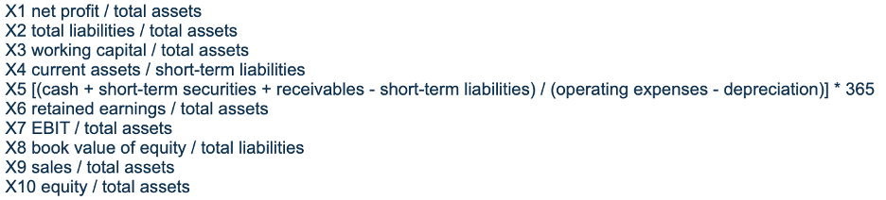
Data Source and Description
DataSource: Polish companies bankruptcy data Data Set
Data description - 43405 records, 64 variables
SAMPLE DATA
Notes:
15s

Slide 5
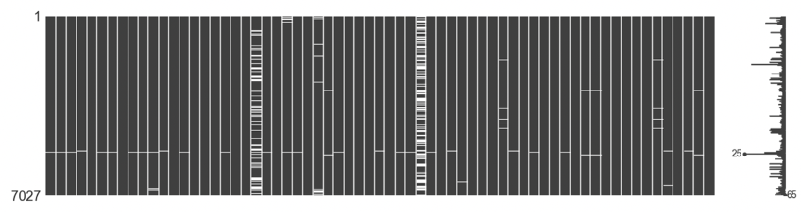
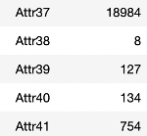
Data Exploration
Check for Missing Value :
Plotted sparsity matrix to identify missing data trends.
We did this for all 5 years data, and almost every column had missing values.
Notes:
45s

Slide 6
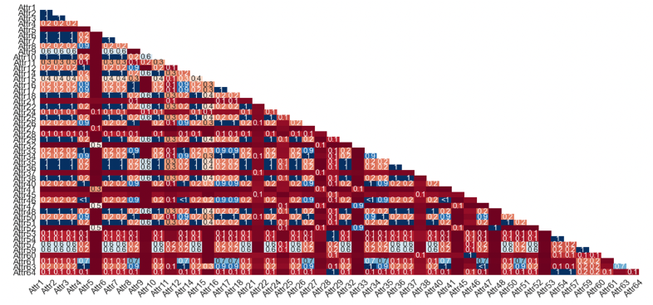
Data Exploration
Is there a trend in between the missing records?
There are few features having corresponding missing values (R=1).
There are few features having missing values in an non-correlated way (R close to 0).
The degree of nullity is different for different years.
Notes:
1

Slide 7
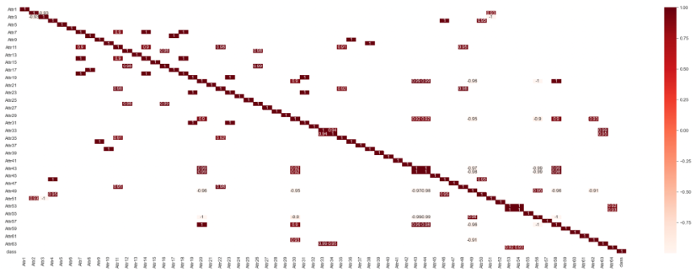
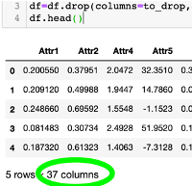
Data Exploration
High correlation cutoff selected - 0.9
Notes:
30

Slide 8
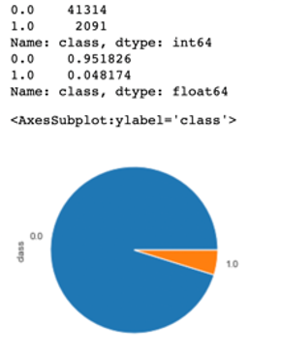
Data Exploration
Class imbalance check
Notes:
30

Slide 9
Machine Learning Models
Data model | Advantages | Disadvantages
Logistic Regression | Easy implementation, interpretation and efficient to train for binary prediction Can also be used for profiling Works well on separable data Maximizes the posterior class probability | Difficult to obtain complex relationships Requires average/no multicollinearity between independent variables
SVM | Maximizes margin between closest support vectors Multicollinearity doesn't matter | Doesn’t work well with large data set Training is time consuming

Slide 10
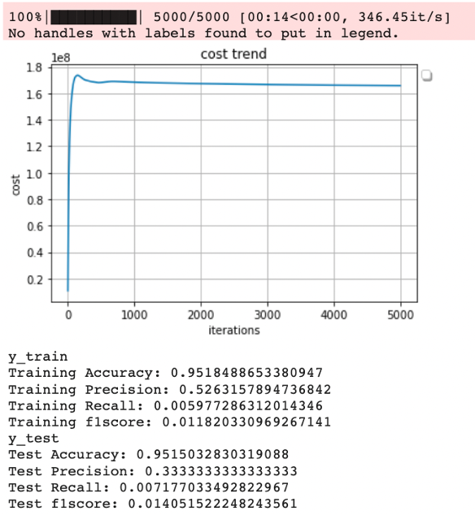
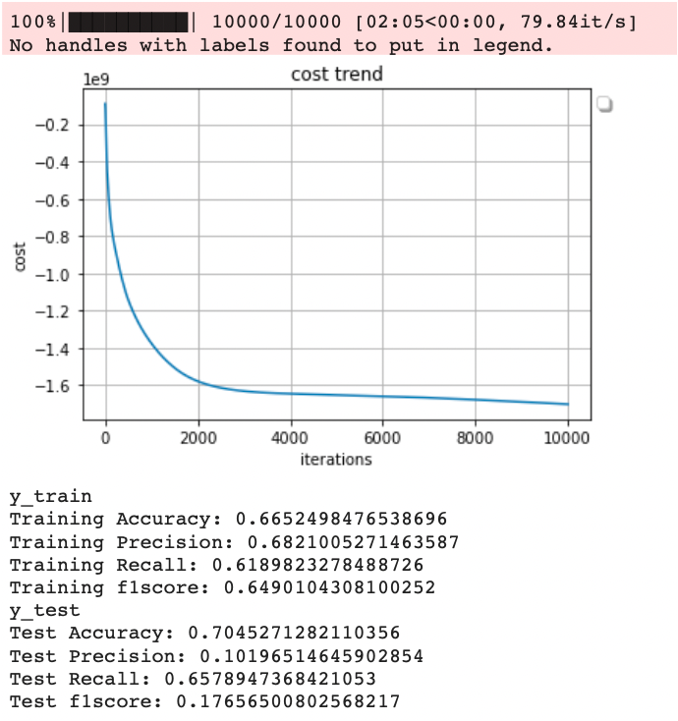
Logistic Regression
Parameters: tolerance=0.0001, learningRate=0.00001
WITHOUT SMOTE
WITH SMOTE

Slide 11
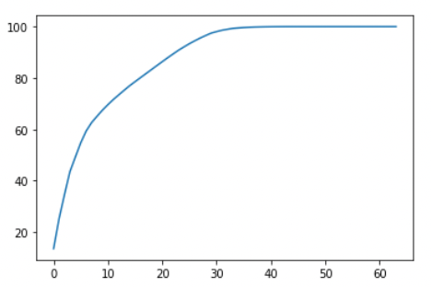
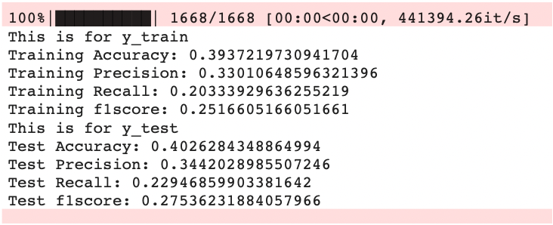
SVM
PCA
30 components
Result

Slide 12
Performance Evaluation
Model name | Accuracy | Recall | Precision | F1 score
Logistic Regression(Without Smote) | 95.15% | 0.7% | 33.33% | 1.4%
Logistic Regression(With Smote) | 70.45% | 65.78% | 10.19% | 17.75%
SoftMargin SVM | 40.26% | 22.94% | 34.42% | 27.53%

Slide 13
Results
Oversampling by SMOTE technique improved the performance of logistic regression model.
F1 score of the baseline logistic regression model was low.
PCA reduced the time taken to train the model.
SVM gave a better f1 score at the cost of recall. Hence, not a great model.

Slide 14
Conclusion & Recommendation
An ML model was successfully implemented to predict bankruptcy
Recommendations
Implementation of Neural Network to obtain better performance since the data is sensitive and has higher dimensionality.
Reduction or addition of variables using domain knowledge.

Slide 15
THANK YOU!!!

